Slide 1
Merge Sort
Presented BY : Ishwor Khatiwada
LC00017000772
Fundamental of Algorithm

Slide 2
1
Merge Sort Algorithm
It divides the input array into two halves, calls itself for the two halves, and then merges the two sorted halves.
2
Example
Example
3
Time Complexity
Merge Sort is a recursive algorithm ||
Time complexity of Merge Sort is θ(nLogn).
4
APPLICATIONS
CONTENTS
Inversion count problem

Slide 3
01
Merge Sort Algorithm
Merge sort works on the principle of Divide and Conquer. Merge sort repeatedly breaks down a list into several sublists until each sublist consists of a single element and mergig those sublists in a manner that results into a sorted list.
Merge Sort has found usage in parallel applications despite the tough competition posed by other optimal algorithms like Quick Sort. In fact, Merge sort does about 39% fewer comparisons than Quick Sort in the average case.
The top-down merge sort approach is the methodology which uses recursion mechanism.

Slide 4
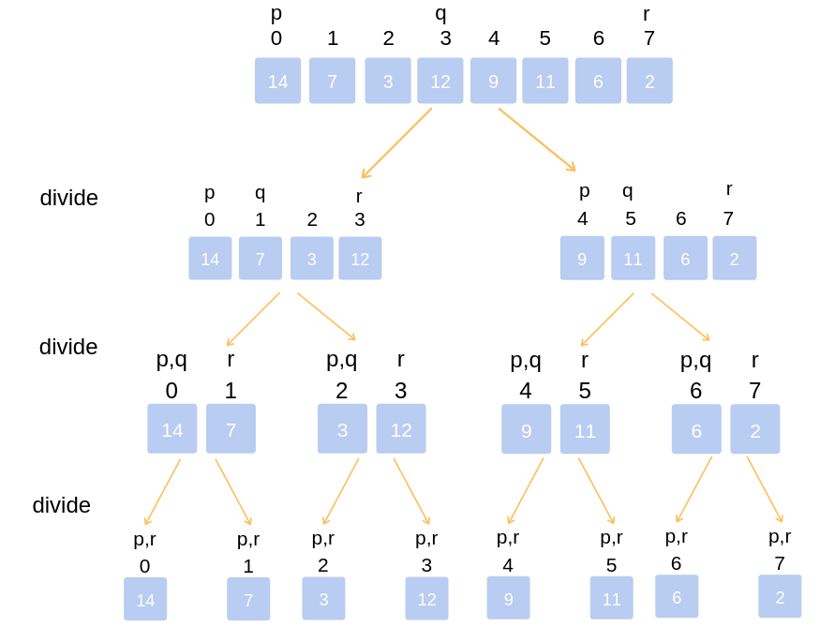
02
Example
Divide the unsorted list into n sublists, each comprising 1 element (a list of 1 element is supposed sorted).

Slide 5
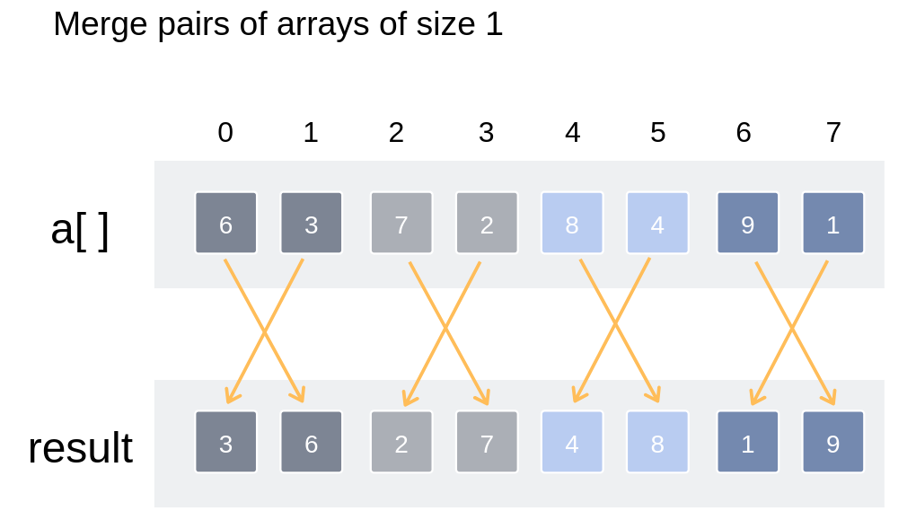
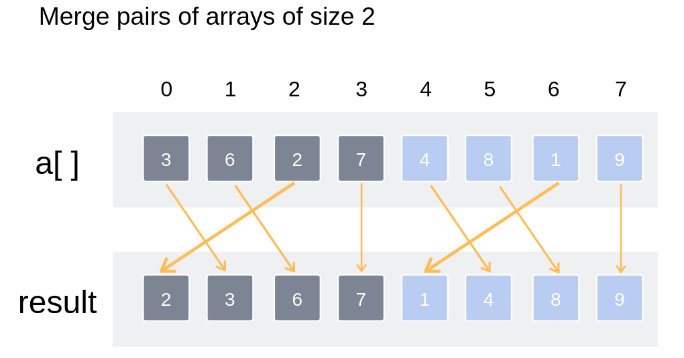
01
Merge Sort Algorithm

Slide 6
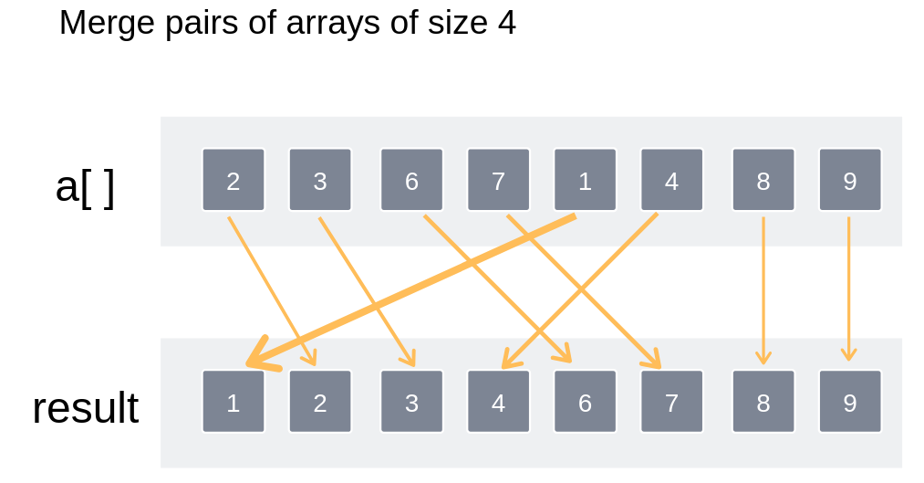
01
Merge Sort Algorithm

Slide 7
01
Time Complexity
Time complexity of Merge Sort is θ(nLogn) in all 3 cases (worst, average and best) as merge sort always divides the array into two halves and takes linear time to merge two halves.

Slide 8
01
Applications
Merge Sort is useful for sorting linked lists in O(n Log n) time
Merge sort can be implemented without extra space for linked lists
Merge sort is used for counting inversions in a list
Input: arr[] = {8, 4, 2, 1} six inversions: (8, 4), (4, 2), (8, 2), (8, 1), (4, 1), (2, 1)
Merge sort is used in external sorting

Slide 9
THANK YOU

